Slide 1
RNNs and LSTMs
임선우

Slide 2
8.1 Recurrent Neural Networks
8.2 RNNs as Language Models
8.3 RNNs for other NLP tasks
8.4 Stacked and Bidirectional RNN architectures
8.5 The LSTM
8.7 The Encoder-Decoder Model with RNNs
8.8 Attention

Slide 3
8.1 Recurrent Neural Networks

Slide 4
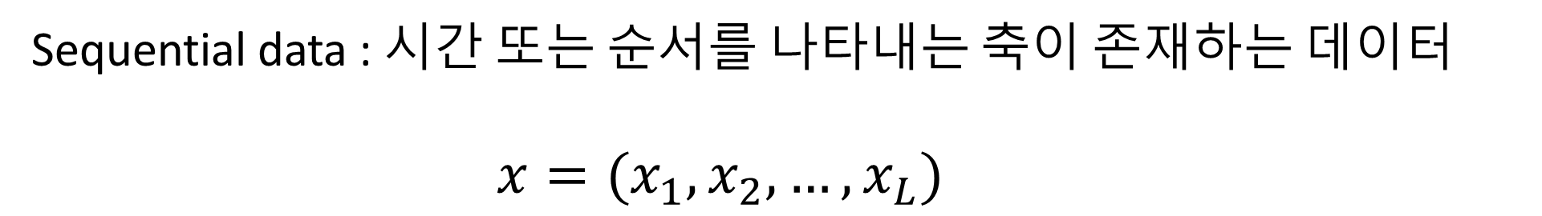
8.1 Recurrent Neural Networks
Sequential data : 시간 또는 순서를 나타내는 축이 존재하는 데이터
$$x=(x_{1},x_{2},…,x_{L})$$
MLP는 데이터의 순서를 따로 고려하지 않음 학습을 통해서만 순서가 고려됨

Slide 5
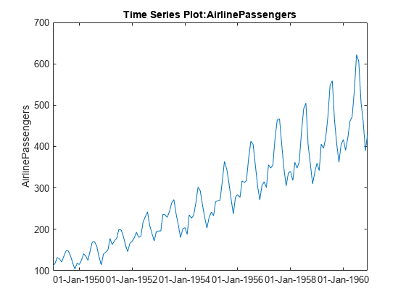

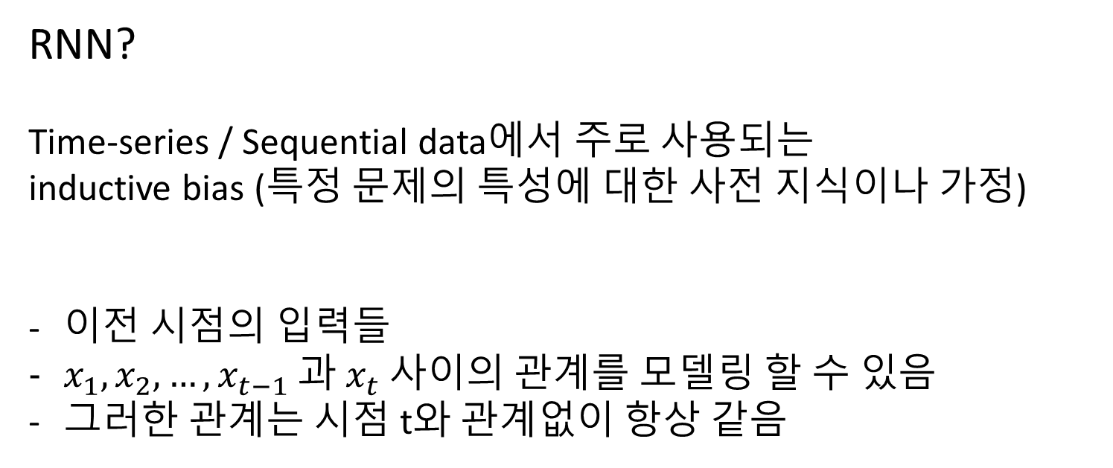
8.1 Recurrent Neural Networks
RNN?
Time-series / Sequential data에서 주로 사용되는
inductive bias (특정 문제의 특성에 대한 사전 지식이나 가정)
이전 시점의 입력들
$x_{1},x_{2},…,x_{t−1} 과$ $x_{t}$ 사이의 관계를 모델링 할 수 있음
그러한 관계는 시점 t와 관계없이 항상 같음

Slide 6
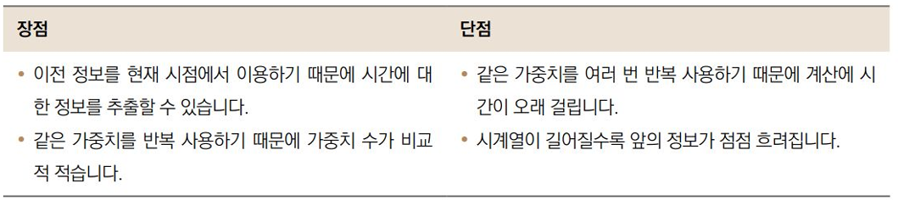
8.1 Recurrent Neural Networks

Slide 7
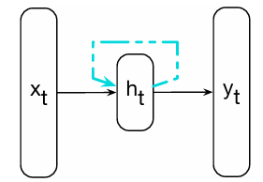
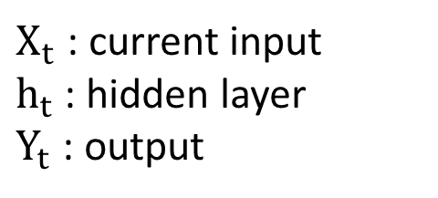
8.1 Recurrent Neural Networks
$X_{t}$ : current input
$h_{t}$ : hidden layer
$Y_{t}$ : output
단순 순환 신경망(SRNN)

Slide 8
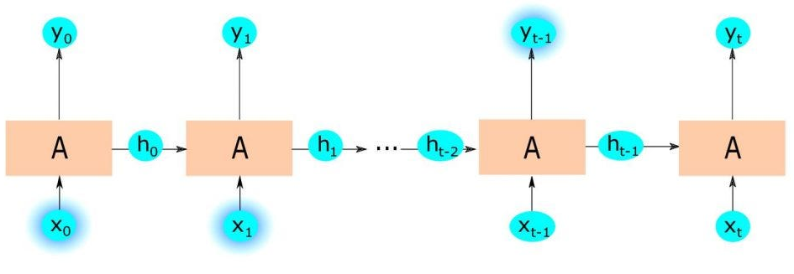
8.1 Recurrent Neural Networks

Slide 9
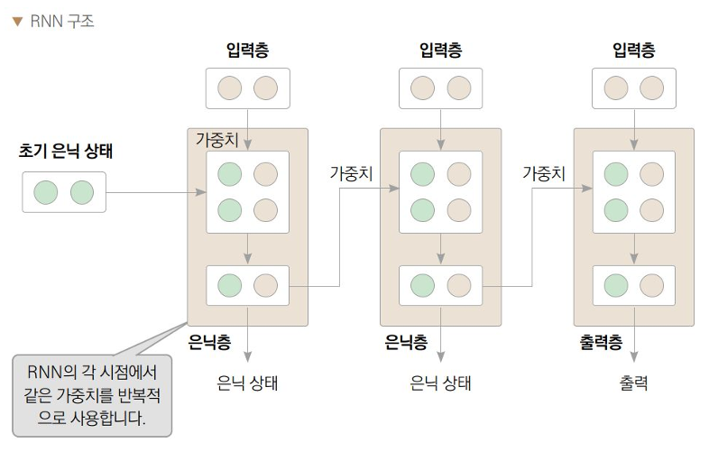
8.1 Recurrent Neural Networks

Slide 10
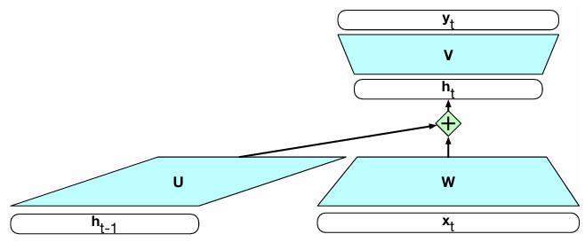

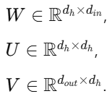
8.1 Recurrent Neural Networks

Slide 11
8.2 RNNs as Language Models

Slide 12


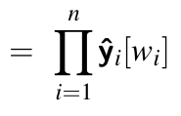
8.2 RNNs as Language Models
RNN을 언어 모델링 작업에 적용하는 방법

Slide 13
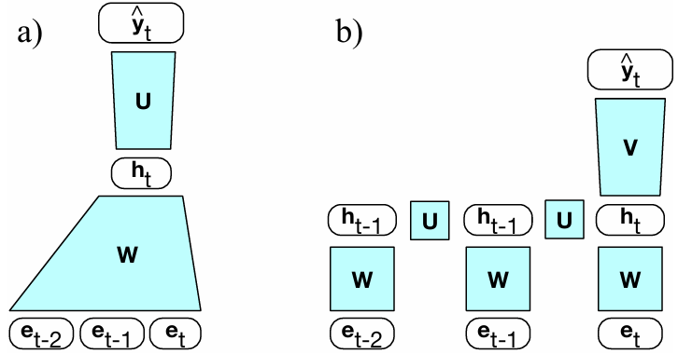
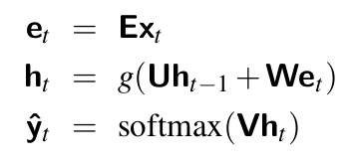
8.2 RNNs as Language Models
Feedforward Language Model
RNNs as Language Models

Slide 14

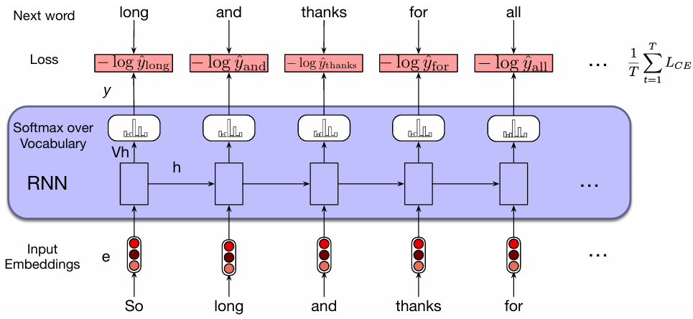

8.2 RNNs as Language Models

Slide 15


8.2 RNNs as Language Models

Slide 16
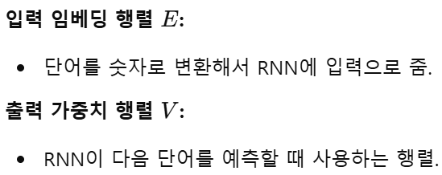

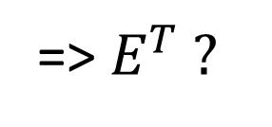
8.2 RNNs as Language Models
Weight Tying
=> $E^{T} ?$

Slide 17
8.3 RNNs for other NLP tasks

Slide 18
8.3 RNNs for other NLP tasks
이를 NLP 작업들에 어떻게 적용할 수 있을까?
시퀀스 레이블링(Sequence Labeling)
시퀀스 분류(Sequence Classification)
텍스트 생성(Text Generation)

Slide 19

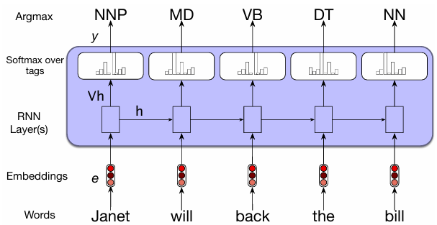
8.3 RNNs for other NLP tasks

Slide 20
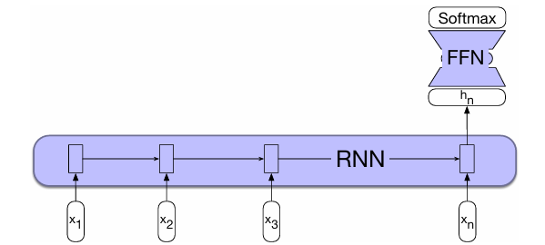
8.3 RNNs for other NLP tasks
감정 분석(긍정/부정), 스팸 메일 분류(스팸/비스팸), …

Slide 21
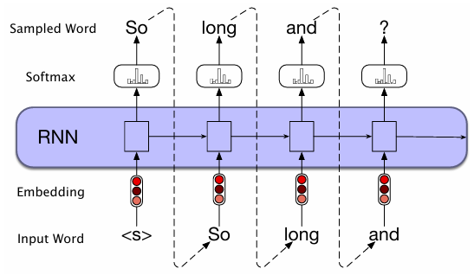
8.3 RNNs for other NLP tasks

Slide 22
8.4 Stacked and Bidirectional RNN architectures

Slide 23
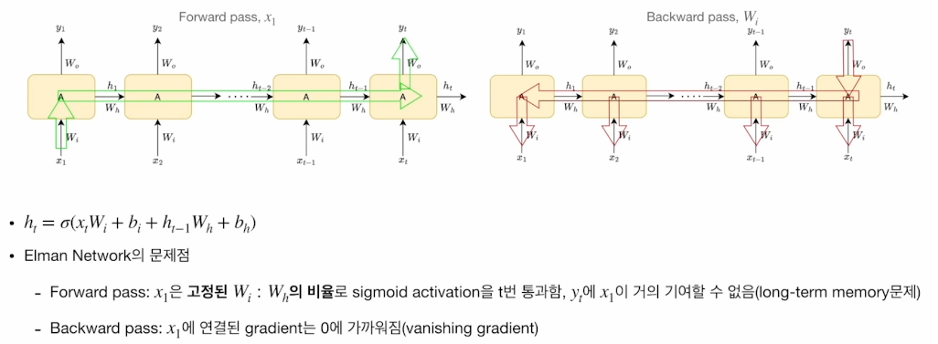
8.4 Stacked and Bidirectional RNN architectures

Slide 24


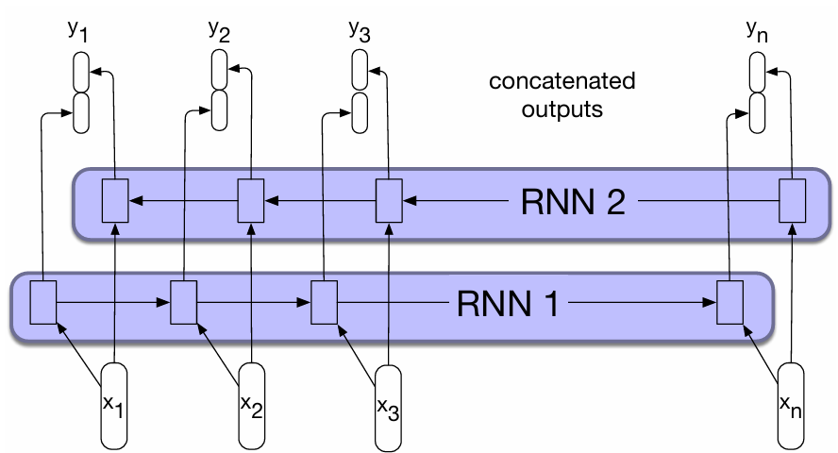
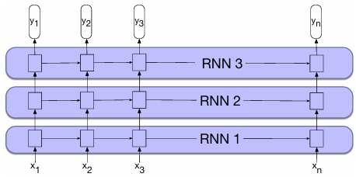
8.4 Stacked and Bidirectional RNN architectures

Slide 25
8.4 Stacked and Bidirectional RNN architectures
Long – Term Memory
=> Long Short Term Memory (LSTM)

Slide 26
8.5 The LSTM

Slide 27
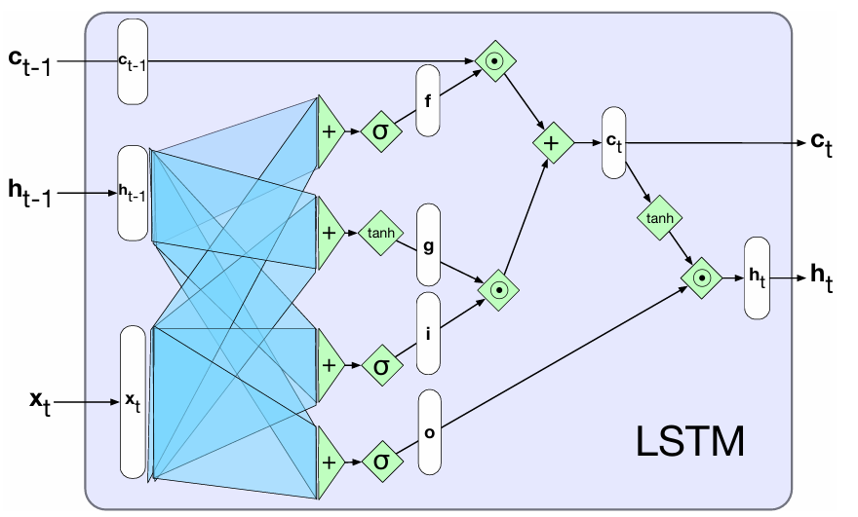
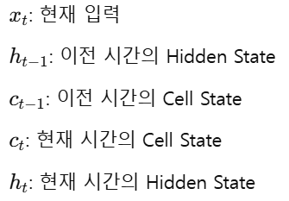
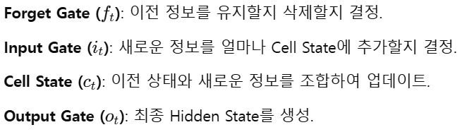
8.5 The LSTM

Slide 28
8.7 The Encoder-Decoder Model with RNNs

Slide 29
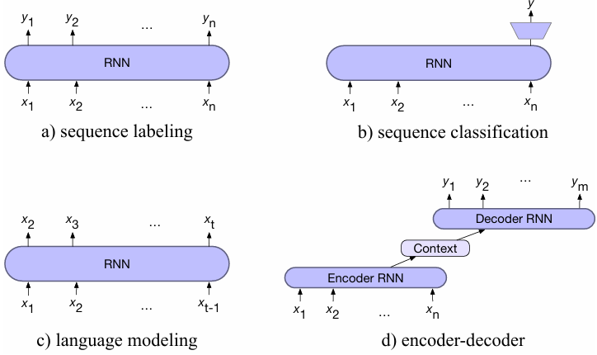
8.7 The Encoder-Decoder Model with RNNs
Context Vector : Contextualized Representation

Slide 30
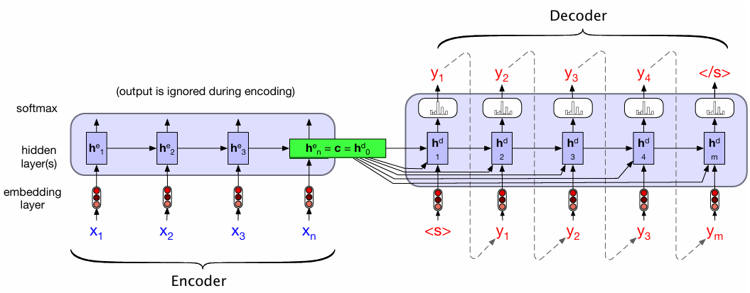

8.7 The Encoder-Decoder Model with RNNs

Slide 31
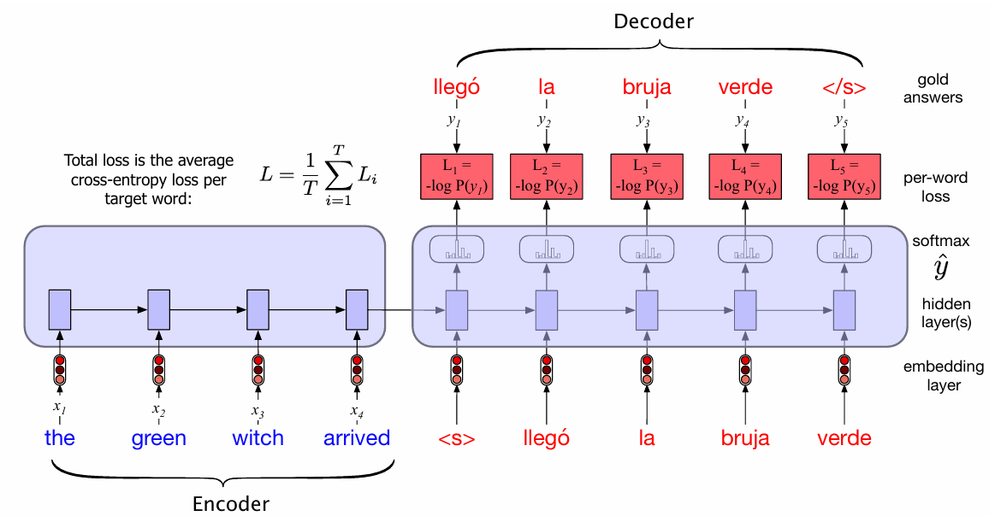
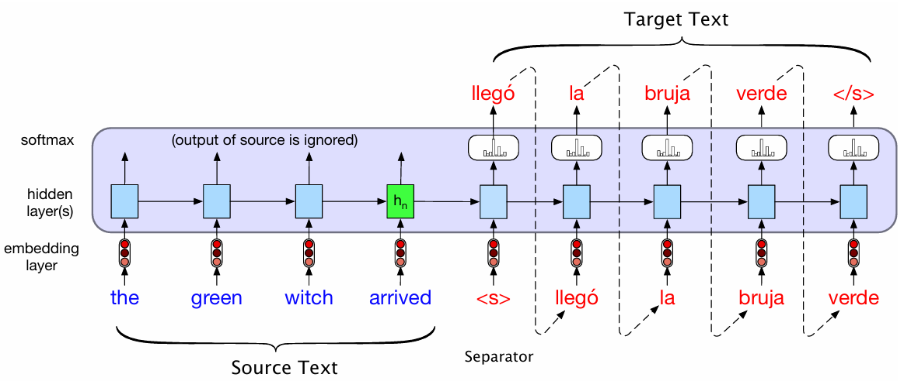
8.7 The Encoder-Decoder Model with RNNs
추론
학습

Slide 32
8.8 Attention

Slide 33
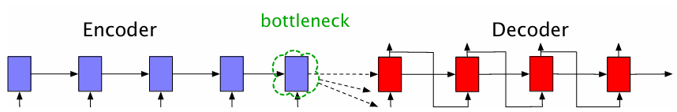

8.8 Attention
Attention : Bottleneck(병목 문제) 를 해결하기 위해 등장

Slide 34

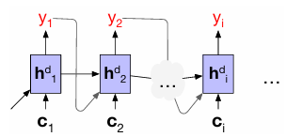

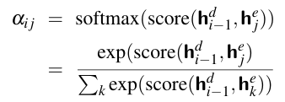

8.8 Attention

Slide 35
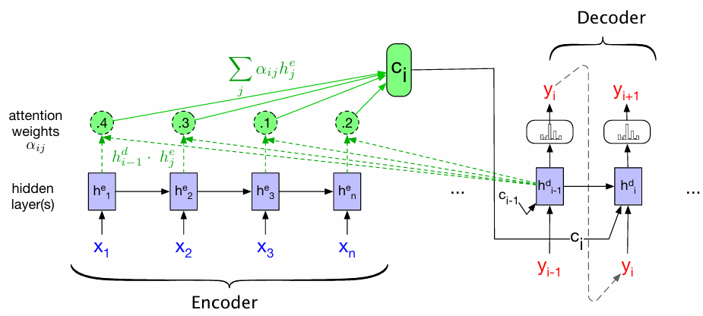
8.8 Attention

